Slide 1
Daily Study
2017/12/13
김서진

Slide 2
읽은 논문 리스트
Server Trace Analysis for an Optimal Design of Solid State Drives[IJAER’16] (17/12/05)
Write-off loading: Practical power Management for Enterprise Storage [FAST’08] (17/12/06~)
Don’t Let RAID Raid the Lifetime of your SSD Array [Hotstorage’13] (17/12/11~)

Slide 3
Don’t Let RAID Raid the Lifetime of your SSD Array [Hotstorage’13]
Goal
Build a reliability model of SSD based RAID
Motivation
RAID5 could be less endurable because of parity protection
Solution

Slide 4
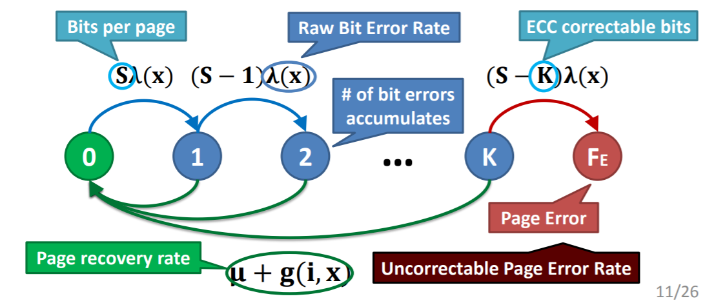
Today 공부한 내용
Markov model
Page Error

Slide 5
Today 공부한 내용
Source of failures
Page error
Device failure
Any failure results in data loss in striping
Parity protection loses data when
Two page errors in the same page group
Two device failures
Page error + device failure
Device failure + page error

Slide 6
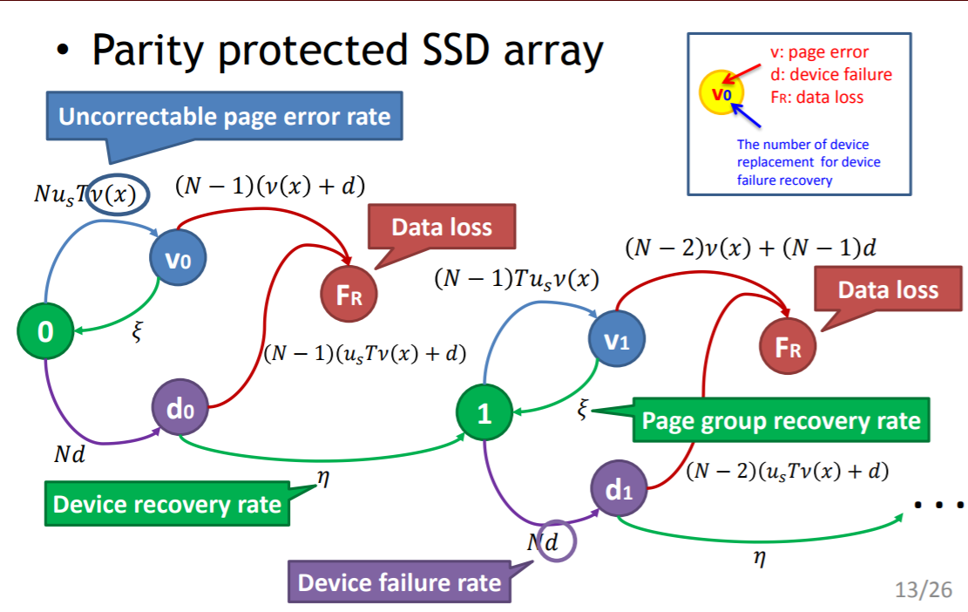
Today 공부한 내용
Source of failures

Slide 7
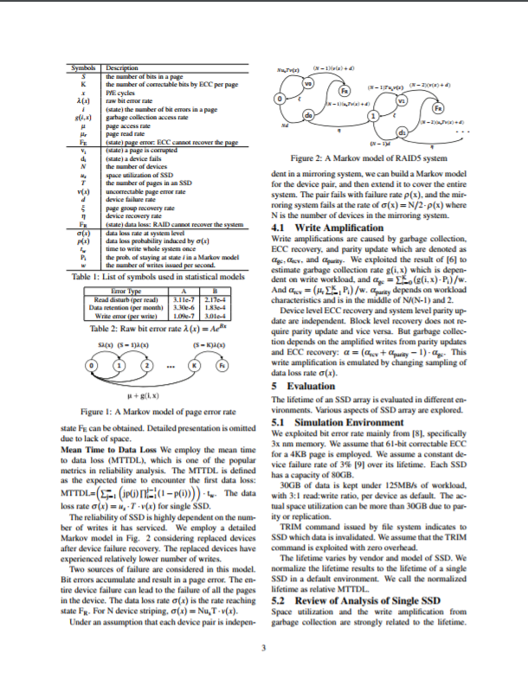
Today 공부한 내용
3p

